Slide 1


Data Privacy Laws and Regulations
GRC104 - Compliance Frameworks and Legal Requirements
International Cybersecurity and Digital Forensics Academy
Week 17: November 3-9, 2025

Slide 2


Introduction to Data Privacy
Why Data Privacy Matters
Data privacy refers to the protection of personal information and the right of individuals to control how their data is collected, used, stored, and shared. It encompasses the legal frameworks, policies, and practices that govern the handling of sensitive information.
Organizations collect unprecedented amounts of personal data in today's digital landscape. With global connectivity and emerging technologies like AI and IoT, privacy challenges continue to grow. Studies show that 87% of consumers will take their business elsewhere if they don't trust a company to handle their data responsibly.
Era
Focus
Key Developments
Basic data protection
First-generation privacy laws
1970s-1990s
Digital privacy
Sector-specific regulations
2000s-2015
Comprehensive protection
GDPR and global privacy laws
2016-Present
Future
Privacy by design
Embedded in technology development

Slide 3

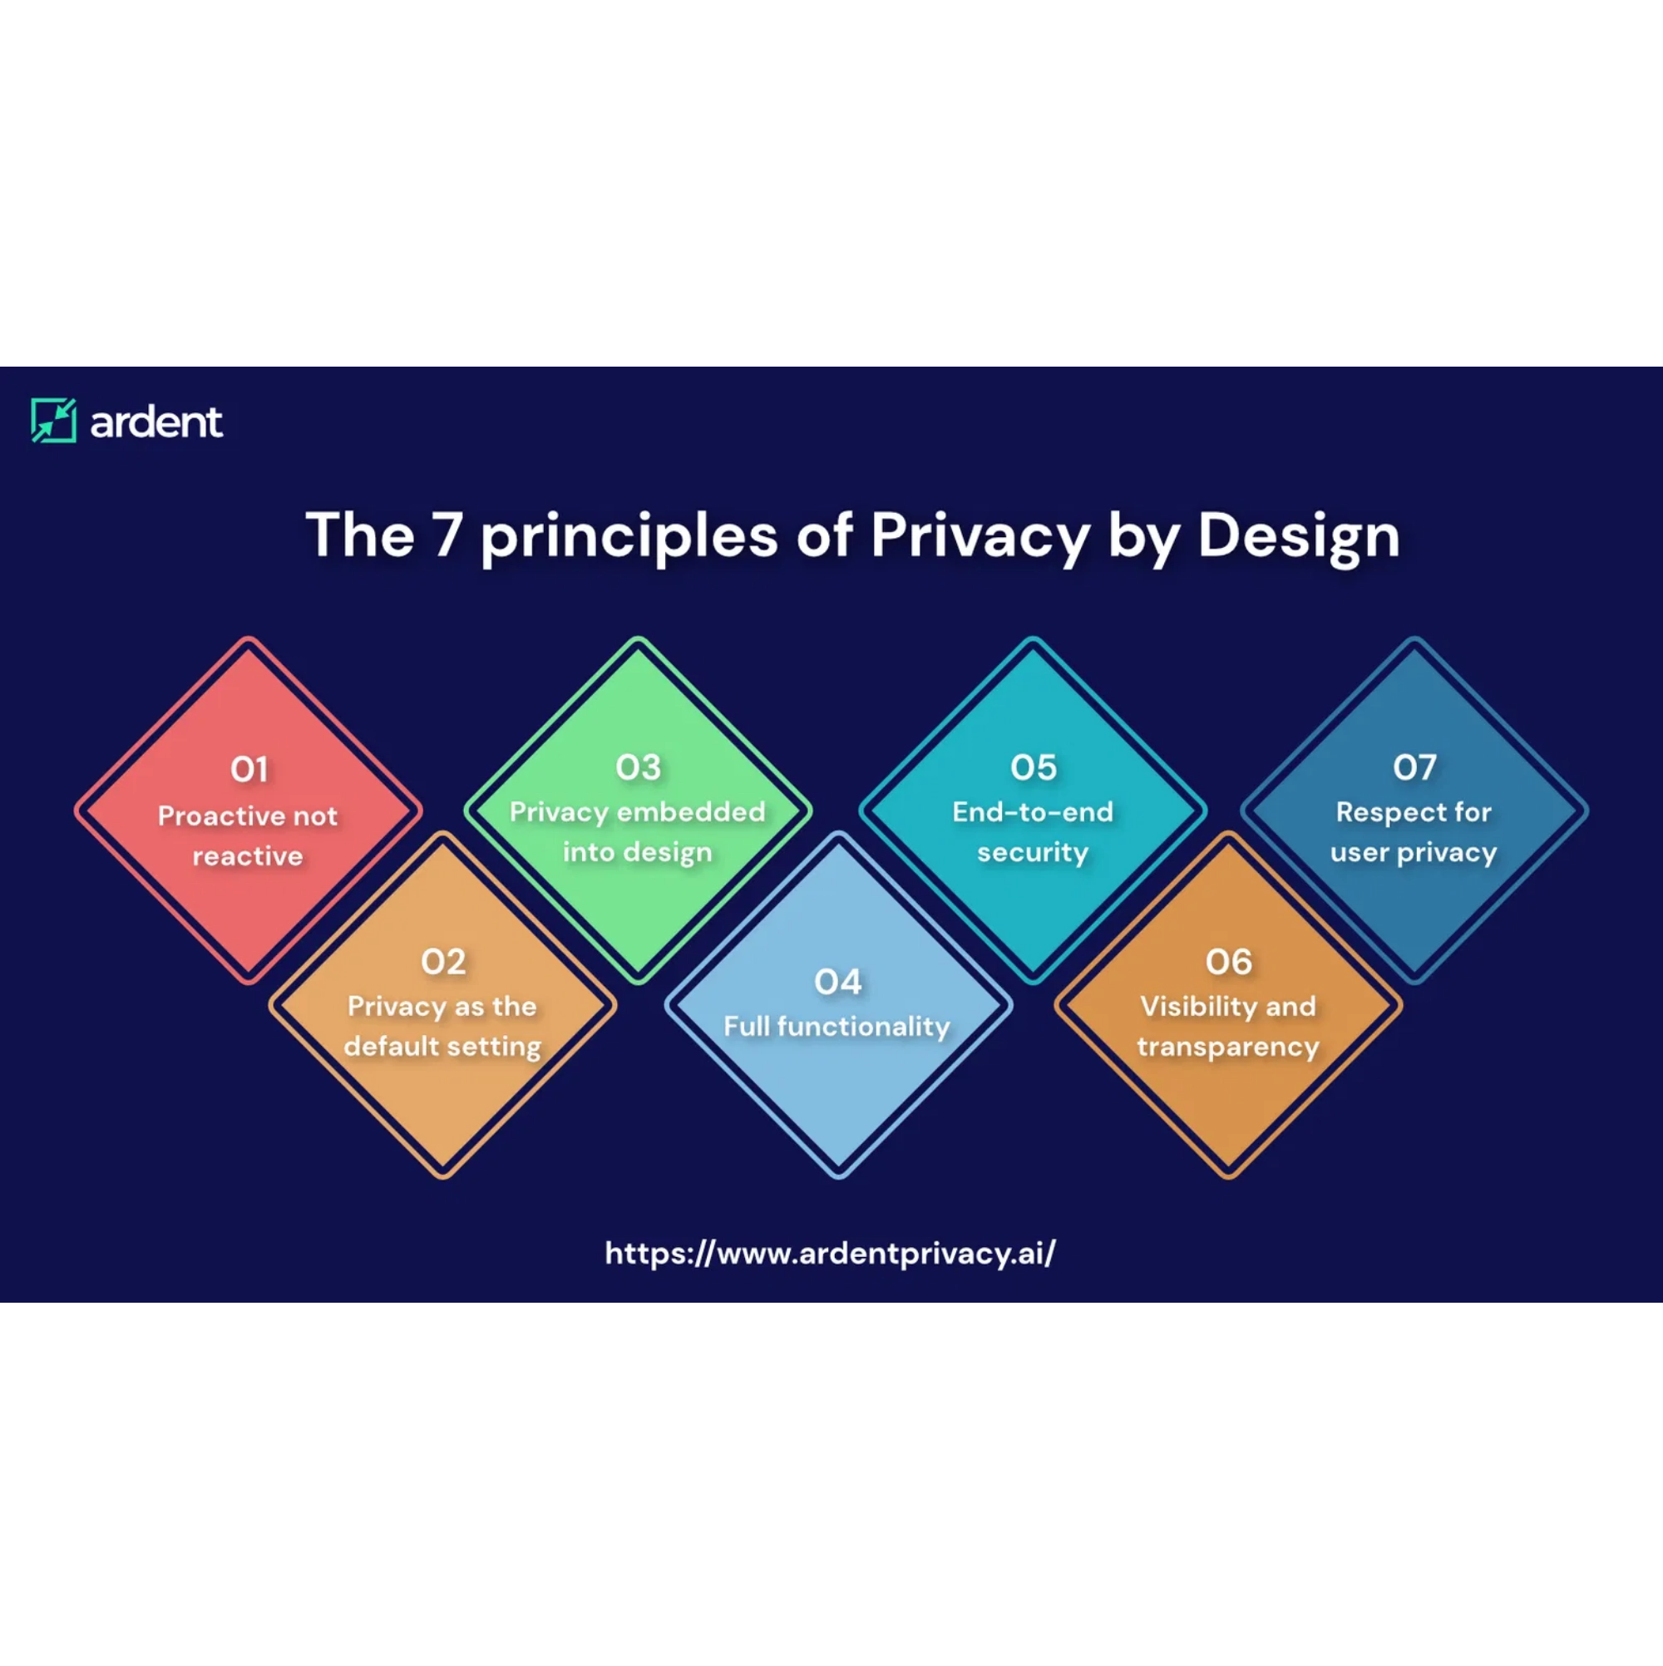
Key Principles of Data Privacy
Integrity and Confidentiality
Appropriate security measures must be implemented to protect personal data against unauthorized access, accidental loss, or damage.
Transparency and Notice
Organizations must clearly inform individuals about how their data is collected, used, and shared through accessible privacy notices.
Accountability
Purpose Limitation
Personal data should only be collected for specified, explicit, and legitimate purposes, and not processed in ways incompatible with those purposes.
Data Minimization
Only collect and retain the minimum amount of personal data necessary to fulfill the stated purpose.
Accuracy
Personal data must be kept accurate and up-to-date, with reasonable steps taken to correct or delete inaccurate information.
Storage Limitation
Data should not be kept longer than necessary for the purposes for which it was collected.
Organizations must demonstrate compliance with privacy principles through documentation, impact assessments, and governance structures.

Slide 4
Major Global Data Privacy Laws (Part 1)
California: CCPA/CPRA
European Union: GDPR
The California Consumer Privacy Act (CCPA), enhanced by the California Privacy Rights Act (CPRA), establishes comprehensive privacy rights for California residents.
The General Data Protection Regulation (GDPR) is the world's most comprehensive data privacy law, effective since May 2018.
Territorial Scope:
Applicability:
Applies to organizations in the EU and those targeting EU residents
Businesses with $25M+ revenue or handling data of 50,000+ consumers
Key Provisions:
Legal basis required for processing, enhanced individual rights
Consumer Rights:
Know, delete, opt-out, non-discrimination
Unique Feature:
Private right of action for data breaches
Data Subject Rights:
Access, rectification, erasure, portability
Penalties:
Up to $7,500 per intentional violation
Penalties:
Up to €20 million or 4% of global annual revenue
Key Difference:
While GDPR is based on the principle that privacy is a
fundamental right, CCPA focuses more on consumer protection and
the right to control personal information as a consumer right.

Slide 5
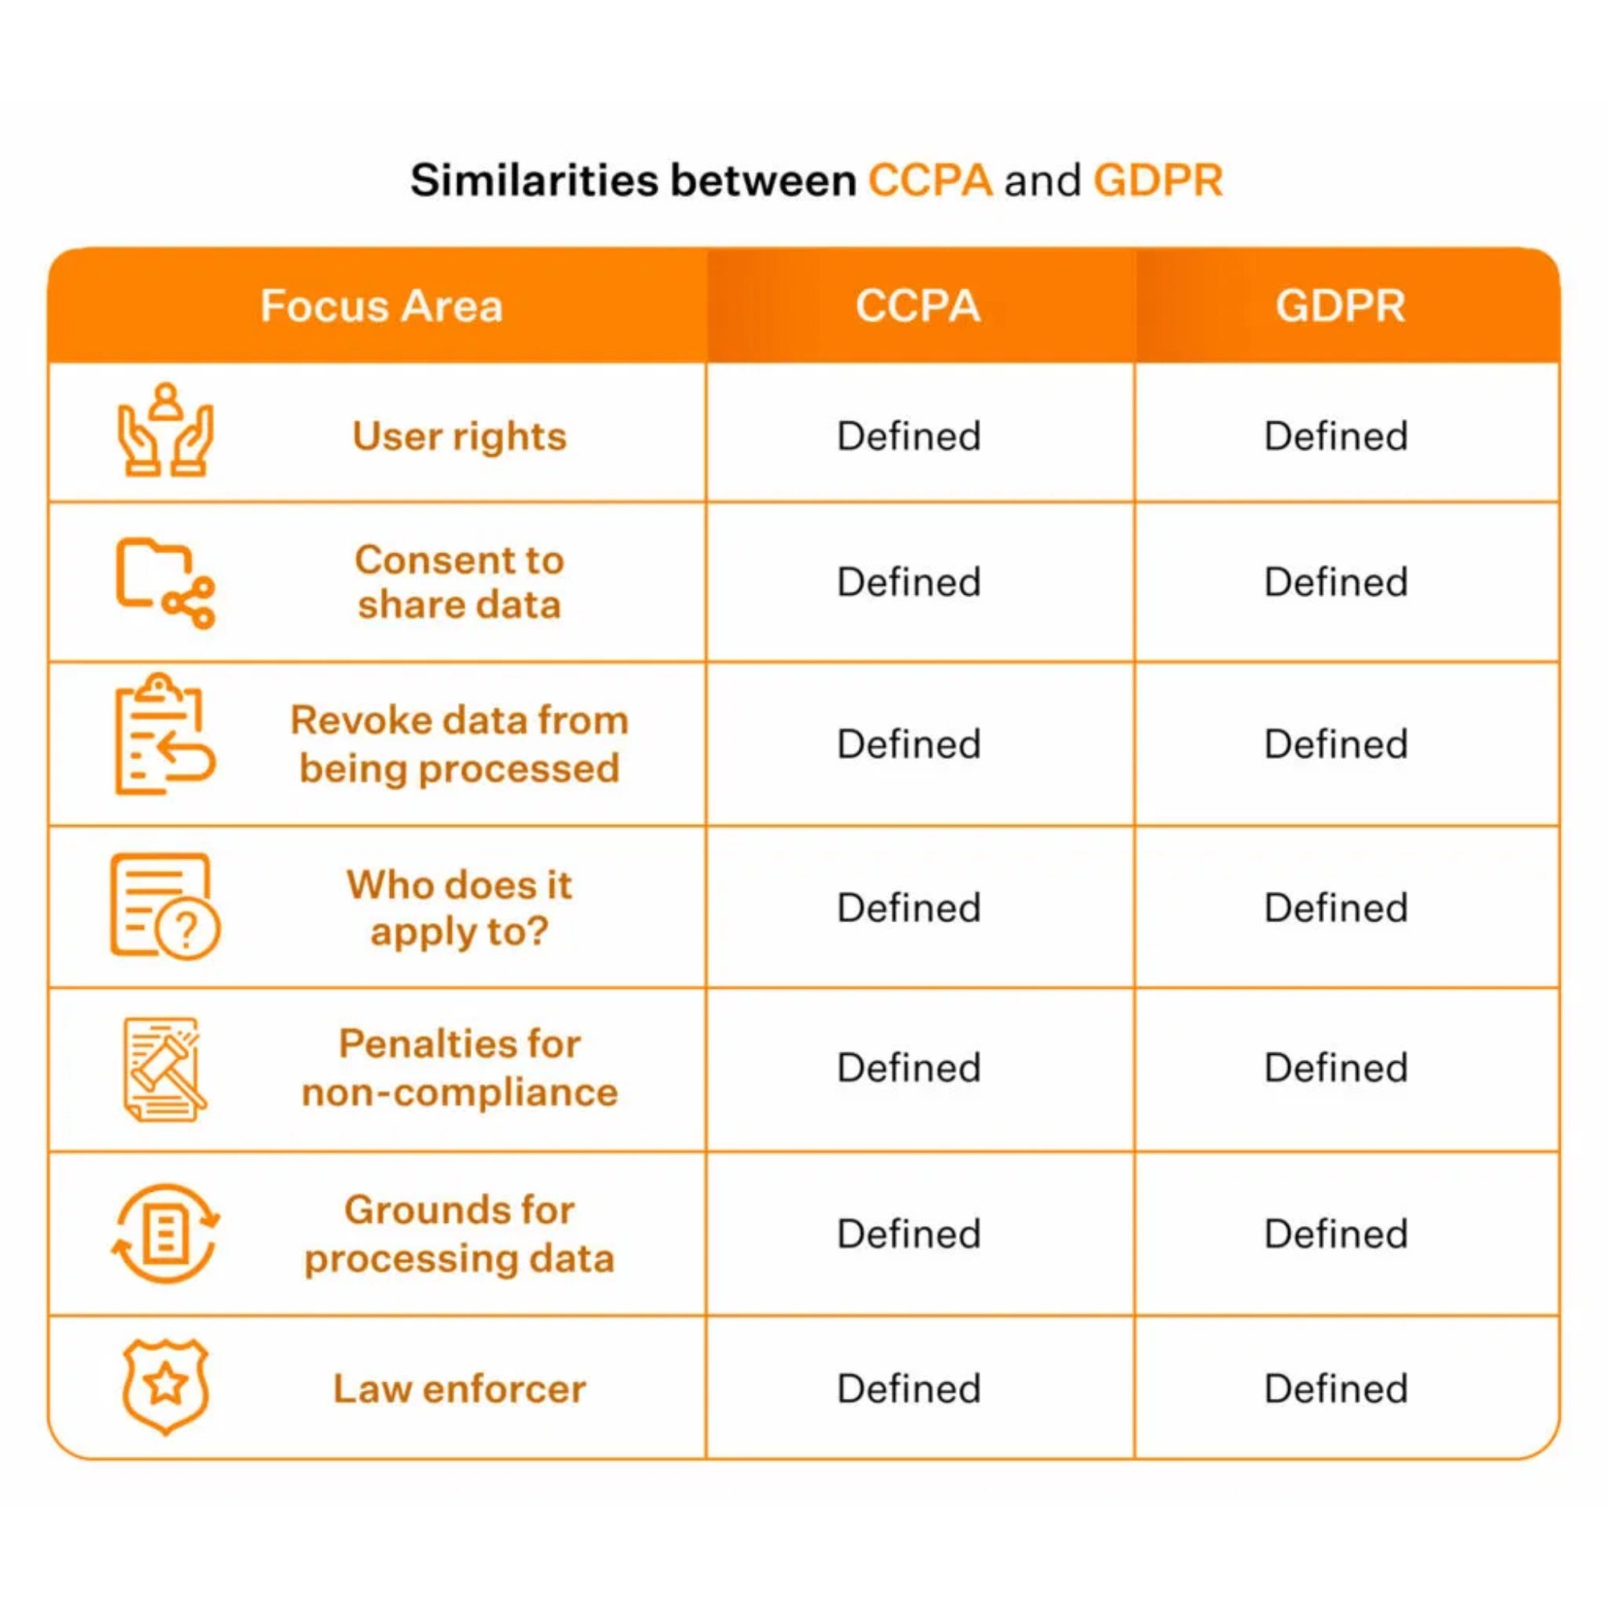






Major Global Data Privacy Laws (Part 2)
Brazil: Lei Geral de Proteção de Dados (LGPD)
The LGPD establishes a comprehensive framework for data protection in Brazil, drawing significant inspiration from the GDPR while maintaining unique elements tailored to the Brazilian context.
Extraterritorial scope similar to GDPR
Ten legal bases for processing personal data
Data subject rights closely mirror those in GDPR
Penalties up to 2% of Brazilian revenue (capped at 50 million reals)
Other Significant Privacy Laws
Canada's PIPEDA:
Based on ten fair information principles
China's PIPL:
Strict data localization requirements
Australia's Privacy Act:
13 Australian Privacy Principles
US State Laws:
Growing patchwork including Virginia, Colorado,
Connecticut, Utah

Slide 6



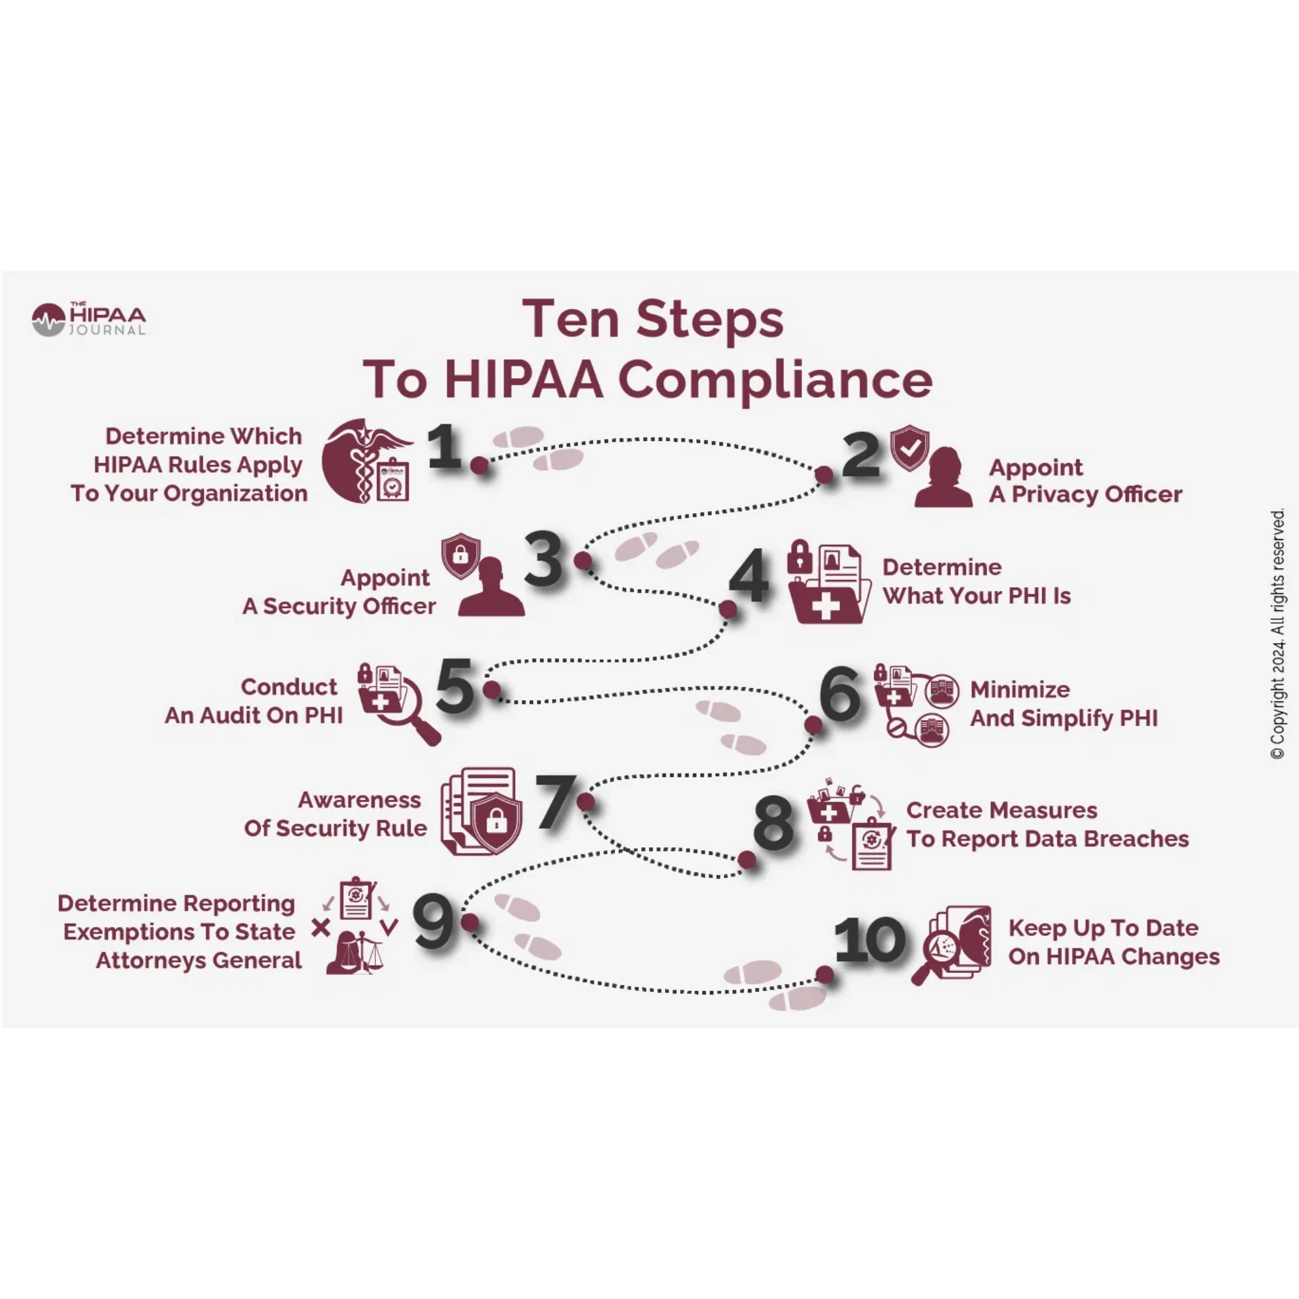
Industry-Specific Privacy Regulations
Healthcare: HIPAA
Financial Services: GLBA
The Health Insurance Portability and Accountability Act (HIPAA) establishes national standards to protect individuals' medical records and other personal health information.
The Gramm-Leach-Bliley Act (GLBA) requires financial institutions to explain their information-sharing practices and safeguard sensitive customer data.
Covered Entities:
Key Components:
Healthcare providers, health plans, clearinghouses
Financial Privacy Rule, Safeguards Rule, Pretexting Provisions
Key Rules:
Applies to:
Privacy Rule, Security Rule, Breach Notification Rule
Banks, securities firms, insurance companies, and other financial service providers
Penalties:
Up to $1.5 million per violation category per year
Other Regulations
Sector
Key Requirements
COPPA
Children's Online Services
Parental consent for collecting data from children under 13
FERPA
Education
Protects privacy of student education records

Slide 7

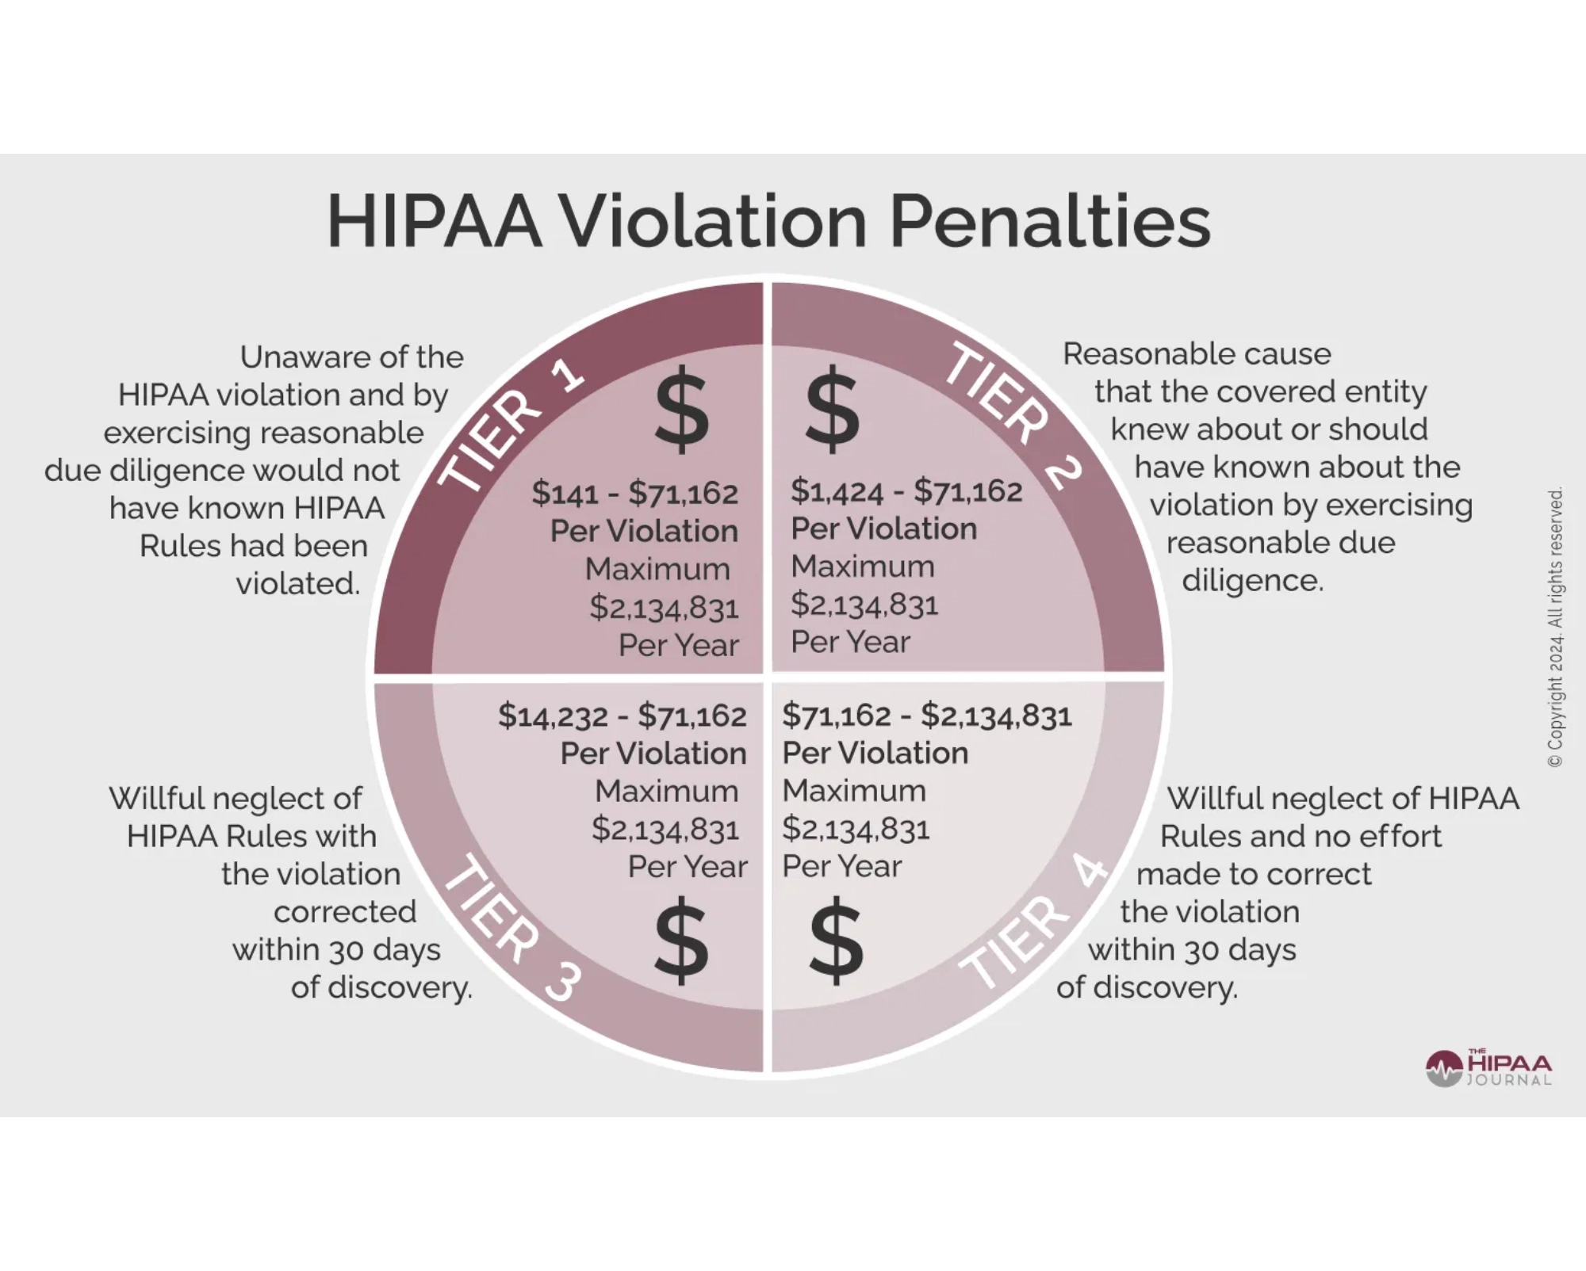





Enforcement and Penalties
Regulatory Authorities
European Data Protection Authorities (DPAs)
Federal Trade Commission (FTC)
Office for Civil Rights (OCR)
State Attorneys General
National Data Protection Authority (ANPD)
Penalties for Non-Compliance
Regulation
Maximum Financial Penalties
GDPR
€20 million or 4% of global annual revenue
Notable Enforcement Actions
CCPA/CPRA
$7,500 per intentional violation
2023:
Amazon fined €746 million by Luxembourg DPA
HIPAA
$1.5 million per violation category per year
2024:
Meta fined €1.2 billion for EU-US data transfers
GLBA
$100,000 per violation
2025:
Major US healthcare provider penalized $15 million
2025:
Financial institution fined $25 million for GLBA violations
LGPD
2% of Brazilian revenue (up to 50 million reals)

Slide 8
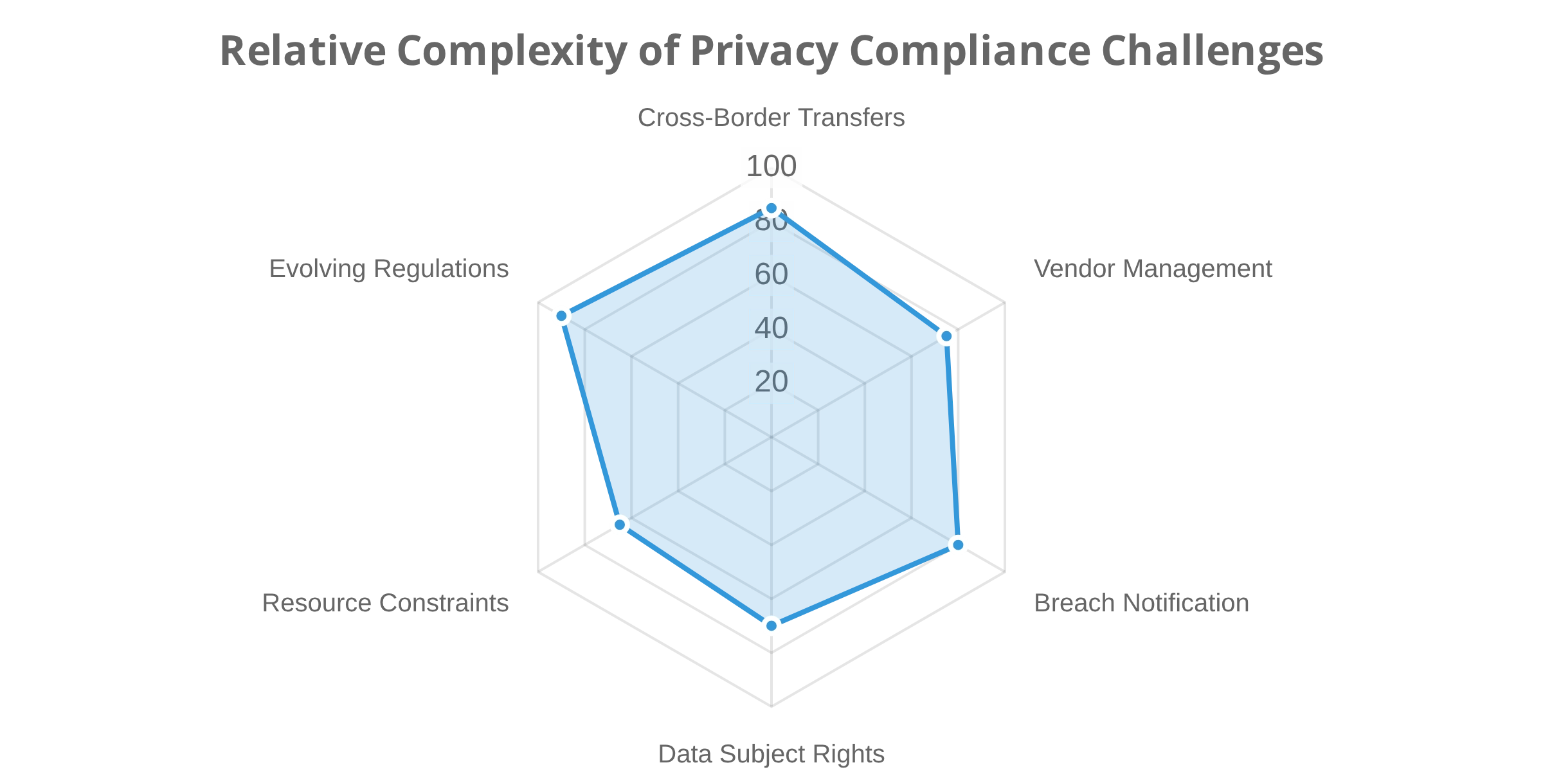
Compliance Challenges
Breach Notification Requirements
Regulation
Timeline
Recipients
Cross-Border Data Transfers
GDPR
72 hours
Supervisory authority, affected individuals
Organizations must navigate complex mechanisms such as Standard Contractual Clauses, Binding Corporate Rules, adequacy decisions, and data localization requirements.
HIPAA
60 days
HHS, affected individuals, media (large breaches)
US State Laws
30-90 days
State AG, affected residents
Vendor Management
Third-party relationships introduce substantial privacy risks requiring comprehensive due diligence, data processing agreements, and regular security assessments.
Evolving Regulations
The rapidly changing global privacy landscape requires organizations to continuously monitor and adapt to new requirements across multiple jurisdictions.
Data Subject Rights
Implementing processes to handle access, deletion, portability, and other requests in a timely manner across complex data ecosystems.

Slide 9






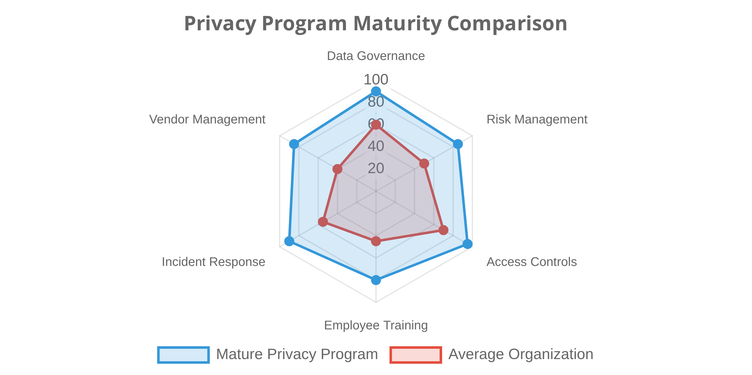


Best Practices for Compliance
Privacy by Design and Default
Privacy by Design represents a proactive approach to embedding privacy into the design and operation of IT systems, business practices, and physical infrastructure from the earliest stages of development.
Incident Response:
Documented procedures for privacy
breaches to reduce impact of incidents
Vendor Management:
Due diligence and contractual safeguards
to mitigate third-party risks
Data Governance Framework:
Maintain comprehensive data
Privacy Notices:
Clear, accessible information practices to build
inventory, classification system, and retention policies
trust and transparency
Risk Management Approach:
Conduct regular Data Protection
Regular Audits:
Systematic review of privacy controls to identify
Impact Assessments (DPIAs) and prioritize high-risk processing
gaps proactively
activities
Access Controls:
Implement role-based access to limit data
exposure based on legitimate need-to-know
Privacy Training:
Regular education for all employees to create a
privacy-aware culture

Slide 10
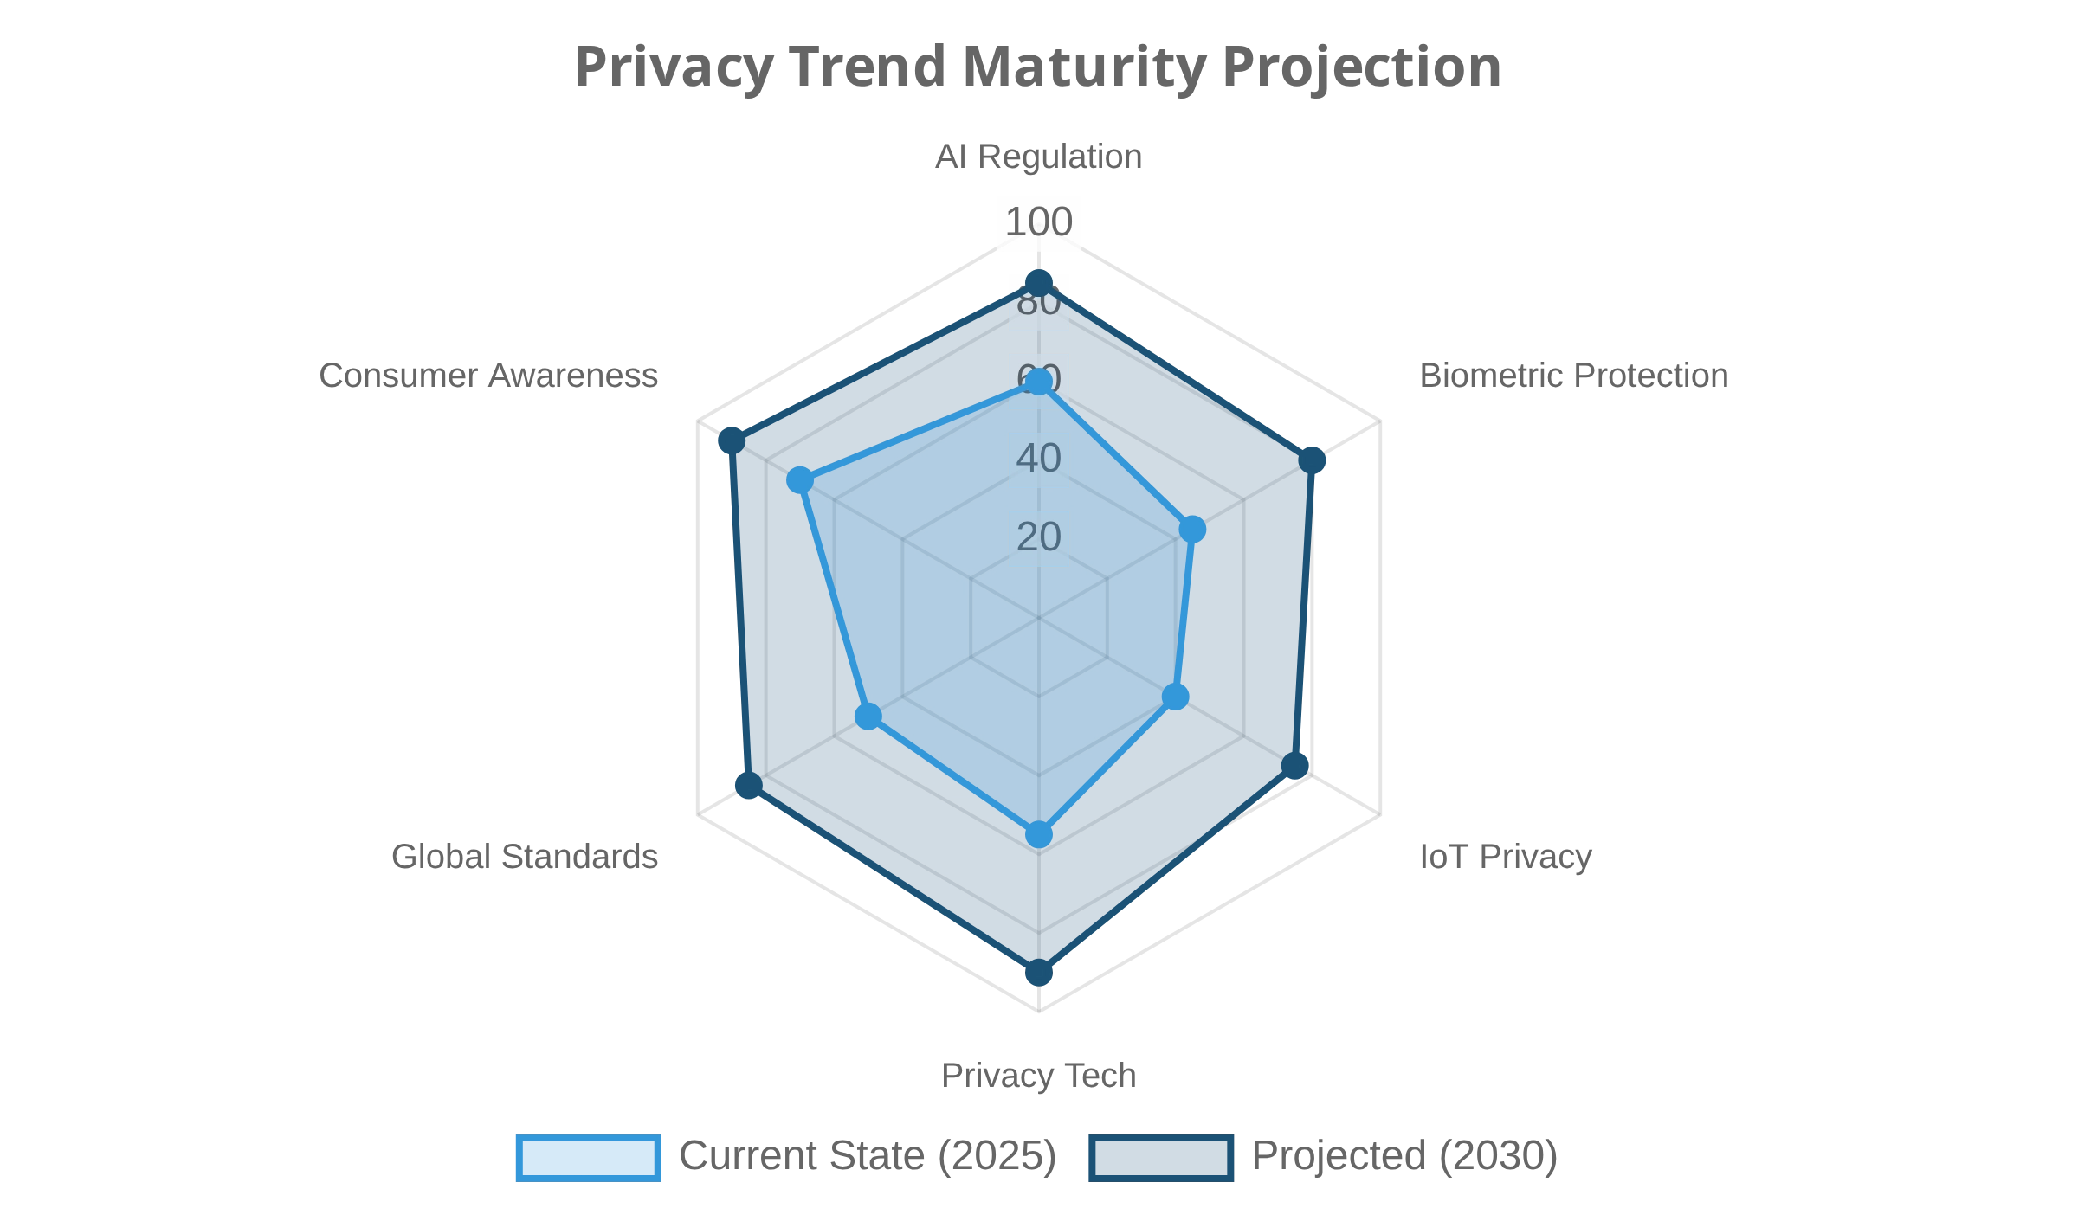









Future Trends in Data Privacy
Artificial Intelligence and Algorithmic Transparency
Increasing focus on explainable AI, algorithmic impact assessments, and regulations addressing automated decision-making.
Biometric Data Protection
Stricter regulations for facial recognition, voice data, and other biometric identifiers as their use becomes more widespread.
Internet of Things (IoT) Privacy
New frameworks addressing the unique challenges of ambient data collection in smart homes, cities, and connected devices.
Privacy-Enhancing Technologies (PETs)
Growing adoption of homomorphic encryption, federated learning, differential privacy, and zero-knowledge proofs.
Global Harmonization
Predictions for 2026 and Beyond
Movement toward more consistent international privacy standards to reduce compliance complexity for global organizations.
Privacy becoming a core competitive differentiator
Automated compliance tools reducing manual privacy workloads
Privacy engineering emerging as a distinct professional discipline
Increased integration between privacy, security, and data governance

Slide 11

Conclusion & Resources
Recommended Resources
Key Takeaways
Resource Type
Recommendations
Data privacy has evolved from a niche legal concern to a fundamental business requirement
Regulatory Guidance
EDPB Guidelines, FTC Privacy Framework, NIST Privacy Framework
Organizations need an integrated approach that embeds privacy into business processes
Industry Organizations
IAPP, Future of Privacy Forum
Risk-based prioritization focuses resources on sensitive data and high-risk processing
Training
IAPP Certifications (CIPP, CIPM, CIPT)
Cultural commitment to privacy must extend beyond legal or compliance departments
Proactive stance anticipates regulatory changes rather than reacting to them

